Slide 1

Potential Threats to the Global Environment
Name: Sherry Hughes
Course Title: SOC 450
Date: September 6, 2020
Instructor: Lucyna-Rabenda-Bajkowska

Slide 2
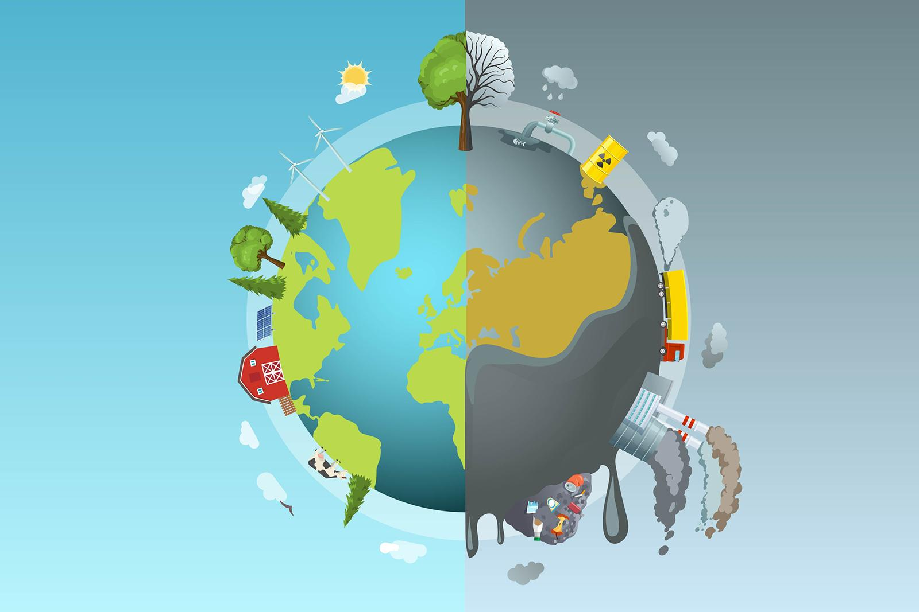
Top 4 Global Threats
Lack of education opportunities
Climate change
Poor health of entire populations
Inappropriate use of Technology
Notes:
I have selected these four threats because they almost cover all the problems given in the table. The major problem with these threats is ignorance and it can be solved only through education. But there is lack of education opportunities in several places in the world. The next in the list is climate change because even the educated are ignorant about it and hence we should enlighten them about the seriousness of this issue. Third in the list is poor health of entire population which is clearly seen given the current pandemic situation. Inappropriate use of technology is fourth in the list because through education this could be prevented, but cannot be completely ignored because the future is completely technological.

Slide 3
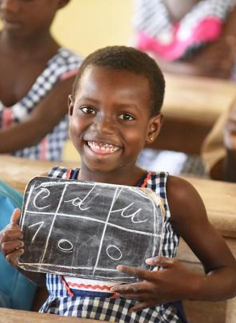
Lack of Education Opportunities
Every child has the right to learn, But has it been fulfilled by the governments of the world. The answer is no due to various reasons such as lack of resources (money). Major effects of lack of education include poor health, lack of a voice, shorter lifespan, unemployment, exploitation and gender inequality. Without the education of people, a society cannot flourish or grow because it does not have the intelligence to build and maintain the society.
Notes:
Major effects of lack of education include poor health, lack of a voice, shorter lifespan, unemployment, exploitation and gender inequality. Without the education of people, a society cannot flourish or grow because it does not have the intelligence to build and maintain the society.

Slide 4
Affect and Effect on countries
The top most affected countries are Chad, Central African Republic, Niger, Guinea, Mali, Sudan, Benin, Yemen, Afghanistan and Liberia.
Access to quality schools is a problem that’s felt the hardest in Africa. Nine out of 10 counties with the highest percentages of children who’ve never attended school were in Africa during the 2000s. The lack of schooling and poor education have negative effects on the population and country. The children leave school without having acquired the basics, which greatly impedes the social and economic development of these countries.
Notes:
Elementary: Three basic things are needed to function in a society: the ability to read, the ability to write and the ability to do basic math functions.
High school: the ability to read more complex texts, the ability to write more complex statements, and the ability to do more complicate math functions.
College: you guessed it.
Everything else we learn is based on those three basics.
Hence it is important for us to implement education as a necessity.
For example, Statistics show that people without a high school diploma will earn at or below the poverty level. That translates to medical discrepancies, food insufficiencies, and lack of ammenities that many people take for granted, like owning a car, car insurance, and home internet. Those without education can not afford to miss work, and have a harder time than others saving money to buy a house or for retirement.

Slide 5

Effects on the world
A lack of education is a big global problem. Especially in poor countries, many children suffer from educational inequality, which may in turn lead to several severe issues when these children turn into grownups.
Therefore, it is crucial to fight the problem of a lack of education on a global scale. By doing so, we can ensure a brighter future for many people worldwide.
Notes:
Many people might not even be aware of what a lack of education really means for their children. Parents may believe that a basic education taught at home is sufficient to succeed in life since they do not know better. However, with our technological progress, it is likely that education will be more important than ever to succeed in our nowadays job market.

Slide 6
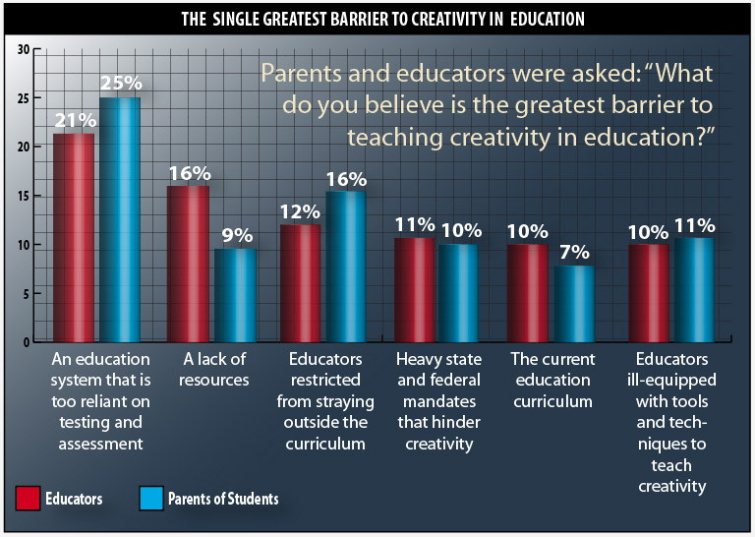
How to eradicate Lack of Education?
The shortest way to implement education worldwide is through creativity and awareness.
Notes:
Solutions for a Lack of Education
Better educational infrastructure
Financial support for poor families
Raise awareness on the importance of education
More tolerance regarding education
Minimum wages
Increase in quality regarding social security
Improvements in health insurance
Support for children from difficult family conditions
Improve quality of teachers
Close teacher gaps
Improve access to education for girls and women

Slide 7
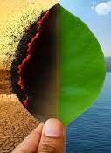
Climate Change
Climate Change is the defining issue of our time and we are at a defining moment. From shifting weather patterns that threaten food production, to rising sea levels that increase the risk of catastrophic flooding, the impacts of climate change are global in scope and unprecedented in scale. Without drastic action today, adapting to these impacts in the future will be more difficult and costly.
Notes:
Climate Change is the defining issue of our time and we are at a defining moment. Greenhouse gases occur naturally and are essential to the survival of humans and millions of other living things, by keeping some of the sun’s warmth from reflecting back into space and making Earth liveable. But after more than a century and a half of industrialization, deforestation, and large scale agriculture, quantities of greenhouse gases in the atmosphere have risen to record levels not seen in three million years. As populations, economies and standards of living grow, so does the cumulative level of greenhouse gas (GHGs) emissions.

Slide 8
Affect and Effect on countries
The top most affected countries are Lagos Nigeria, Haiti, Yemen, UAE, Philippines, Kiribati.
Climate change is expected to affect every country in the world, but its impact will not be felt equally across all regions and some will be worse hit than others because of a range of different threats. Developing countries, places with widespread poverty, and countries with ineffective governments sometimes face the gravest risks from the changing climate, and are usually poorly equipped to find ways to prepare for and prevent environmental threats.
Notes:
Increased heat, drought and insect outbreaks, all linked to climate change, have increased wildfires. Declining water supplies, reduced agricultural yields, health impacts in cities due to heat, and flooding and erosion in coastal areas are additional concerns.

Slide 9
Effects on the world
Climate change is having serious impacts on the world's water systems through more flooding and droughts. Warmer air can hold a higher water content, which makes rainfall patterns more extreme. Rivers and lakes supply drinking water for people and animals and are a vital resource for farming and industry.
Notes:
Decreased water availability will have economic and environmental impacts. Midwest. Extreme heat, heavy downpours and flooding will affect infrastructure, health, agriculture, forestry, transportation, air and water quality, and more. Climate change will also exacerbate a range of risks to the Great Lakes.

Slide 10
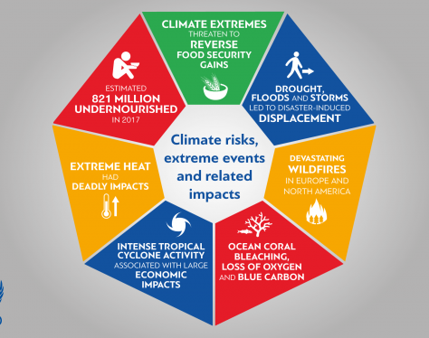
Climate change impacts
Given are the impacts of climate change which should be eradicated.
Notes:
How You Can Stop Global Warming
Speak up!
Power your home with renewable energy.
Weatherize, weatherize, weatherize.
Invest in energy-efficient appliances.
Reduce water waste.
Actually eat the food you buy—and make less of it meat.
Buy better bulbs.
Pull the plug(s).

Slide 11
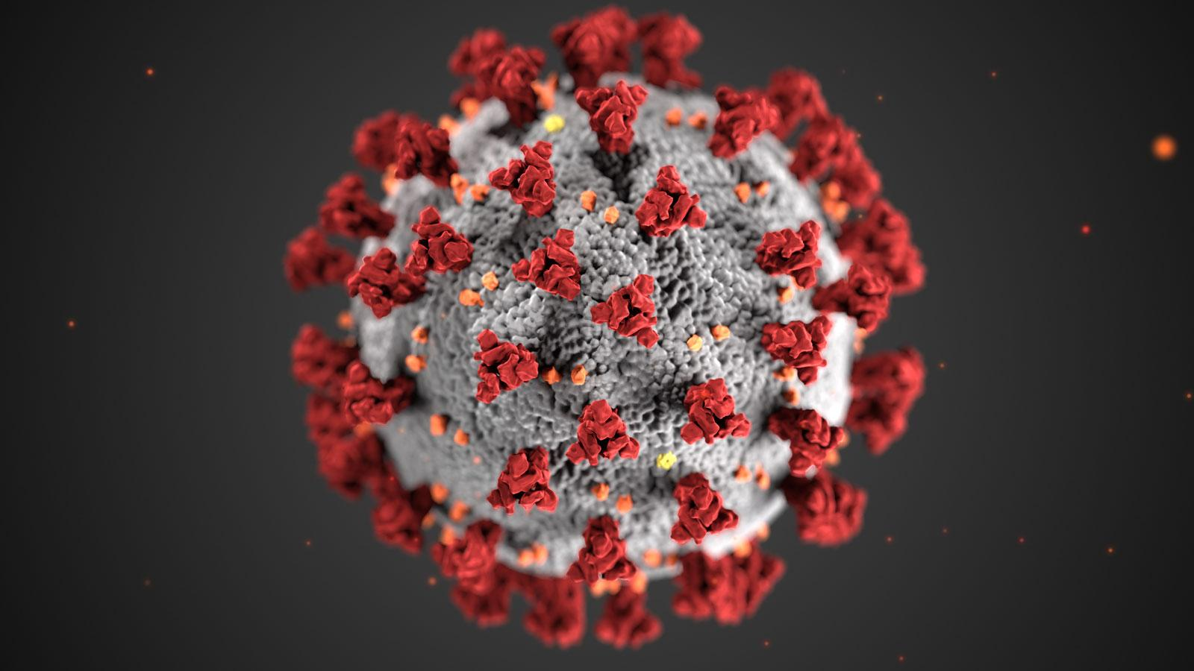
Poor health of entire populations
Poverty is both a cause and a consequence of poor health. Poverty increases the chances of poor health. Poor health, in turn, traps communities in poverty. Infectious and neglected tropical diseases kill and weaken millions of the poorest and most vulnerable people each year.
Notes:
HIV, diarrhoea, tuberculosis and malaria, as well as communicable respiratory diseases such as pneumonia kill the most people. Diarrhoea, pneumonia and malaria account for nearly half of all child deaths globally.
Neglected tropical diseases affect over one billion people, almost all in the poorest and most marginalised communities. You may not have heard of diseases such as leprosy, lymphatic filariasis, onchocerciasis, schistosomiasis, soil-transmitted helminths and trachoma, but they can cause severe pain and life-long disabilities – and mean enormous productivity losses. However, efforts to tackle them have usually taken a back seat to the bigger killers.

Slide 12
Affect and Effect on countries
The top most affected countries are Sub-Saharan Africa and South Asia are the most affected by this issue. In these regions, five countries namely India, Nigeria, Democratic Republic of Congo, Pakistan and Ethiopia account for over half of deaths worldwide.
In many countries the populations do not benefit from health coverage. Thus, they do not have access to healthcare that remains beyond their means. Some must save up for years before being able to see a doctor or a specialist. Additionally, the large pharmaceutical companies because of their medicines’ extreme prices compound the precarious situation of the populations at risk. These are the people most in need of the medicine.
Notes:
In developing countries, vaccination levels are very low. In 2009, 24 million children from the poorest countries did not have access to the basic vaccines. Yet, the vaccination of these children could decrease the death rate of children linked to infectious diseases by 45%. In addition, these countries usually don’t have enough staff and healthcare equipment to offer healthcare access to the most in need. The countries of Sub-Saharan Africa and South East Asia only count 1 doctor for over 2000 inhabitants; this is 6 times less than in developed countries. Additionally, care cannot be given to everyone and many children die because of a lack of health coverage or having waited too long before undergoing examination or vital care.

Slide 13
Effects on the world
A healthy population is essential for economic development. The poorest people on the planet tend to suffer most from the health effects from exposures to environmental hazards like air pollution and impure water. In turn, disease and disability related to polluted environments slows and blocks economic development.
Notes:
Economic development has led to tremendous improvements in people’s well-being, but often at the expense of the environment. Industrialization has contributed to pollution of air and water, changing dietary patterns, and shifting patterns of transportation and land use. Exposures to air and water pollutants directly increase disease. Similarly, dietary changes and decreased levels of physical activity, resulting from transportation and other work and lifestyle changes, are contributing to global epidemics of obesity, diabetes, and associated diseases. Globalization and the large geographic scale over which rapid industrialization is occurring make these environmental health problems global health problems.

Slide 14
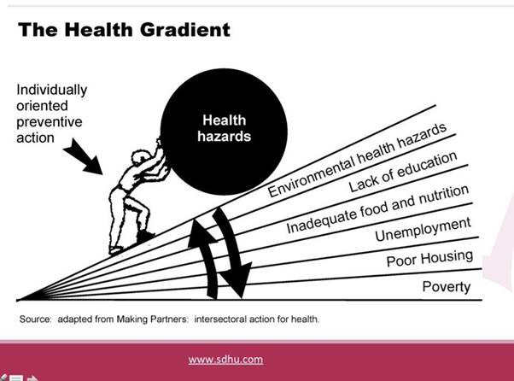
Health hazards
This picture shows the level of contribution of elements to health hazards.
Notes:
Protecting and creating healthy environments is a critical component of sustainable development. Environmental health can be integrated into sustainable development by:
Improving environmental quality for the poorest populations with the greatest burden of environmental diseases, by reducing exposures to air pollution in homes and villages from biomass burning, and providing clean water and sanitation
Identifying efforts to address environmental problems that can also provide health benefits. For example, creating environments that encourage biking and walking for transportation reduces greenhouse gas and toxic air pollution emissions (environmental benefit) and increases physical activity (health benefit).
Recognizing that some policies, practices, and technologies designed to promote sustainability and economic development may have unintended adverse environmental health effects, and attempting to prevent or mitigate these before they are implemented.

Slide 15

Inappropriate use of Technology
The inappropriate use of technology refers to the misuse of devices that negatively impacts other people or defames their reputation. Technological users have a responsibility to apply technology appropriately without causing harm to others, and they have a right to safety and protection when using devices.
Notes:
Social media and mobile devices may lead to psychological and physical issues, such as eyestrain and difficulty focusing on important tasks. They may also contribute to more serious health conditions, such as depression. The overuse of technology may have a more significant impact on developing children and teenagers.

Slide 16
Affect and Effect on countries
The rapid spread of technology fuelled by the Internet has led to positive cultural changes in developing countries. Easier, faster communication has contributed to the rise of democracy, as well as the alleviation of poverty. Globalization can also increase cultural awareness and promote diversity.
Appropriate technology emphasizes the use of renewable resources, like the energy from the sun, wind, or water. Thus, appropriate technology makes it possible to satisfy our basic human needs while minimizing our impact on the environment and social problems.
Notes:
There are many ways in which technology can be inappropriately used, including:
· Taking images or videos which could be damaging to a persons reputation
· Threatening, humiliation, intimidation and harassment
· Sending computer viruses or forwarding unsuitable content
· Making and sending inappropriate content or using inappropriate content to manipulate others
· Derogatory, defaming or offensive statements
· Intellectual Property theft
· The unauthorised access/downloading of media content such as music and films

Slide 17
Effects on the world
It will not be possible to meet the basic needs of the poor in developing countries within the existing techno structure. The technology produced in the high‐income countries is generally inappropriate for developing countries, being developed to suit conditions in the former. An appropriate technology more productive than a traditional one, but less disruptive than an inappropriate one, is therefore required. Such a technology is better suited to the factor endowments, levels of income, and the social and cultural conditions of developing countries.
Notes:
Various effects are,
1. Menacing, harassing or offensive use of the internet or a mobile
2. Threats and Intimidation
3. Stalking
4. Unauthorised Access
5. Defamation
6. Encouraging suicide

Slide 18
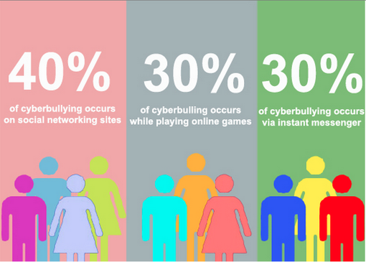
Statistical analysis
This picture shows the statistical data of the inappropriate use of technology.
Notes:
Countries are faced with selecting appropriate industries and technologies. Although the choice between requirements for more or less capital and special skills per worker is not the only choice to be made when making this selection, it is often a highly relevant one. The problem is being further complicated by the fact that industrially advanced countries are on the threshold of a second industrial revolution. Automation, transfer machines and the use of electronics are just beginning to be developed, and further revolutionary changes in technology and production techniques may occur. Unless appropriate choices are made, the present economic and social gap between the industrialized and the developing countries will become even larger.

Slide 19
Key Takeaways
Identifying the threats
Prioritizing them based on certain attributes
Finding a solution
Implementing them with careful assistance

Slide 20

We can conclude by saying that all the threats are interconnected to one another and should therefore be solved based on their priorities.
Thank You

Slide 21

References
UNICEF Staff. (2011). The state of the world's children 2011-executive summary: Adolescence an age of opportunity. Unicef.
Skelton, T. (2007). Children, young people, UNICEF and participation. Children's Geographies, 5(1-2), 165-181.
Unicef. (2011). UNICEF Annual Report 2010. Unicef.

